Slide 1
Hello, Kotlin!

Slide 2










Zoltán Domahidi
domahidizoltan@gmail.com
/in/domahidizoltan
/domahidizoltan
Notes:
https://freeicons.io/

Slide 3

Meet Kotlin
Learn basic Kotlin code (variables, functions, conditions, collections, loops, classes)
Demo

Slide 4
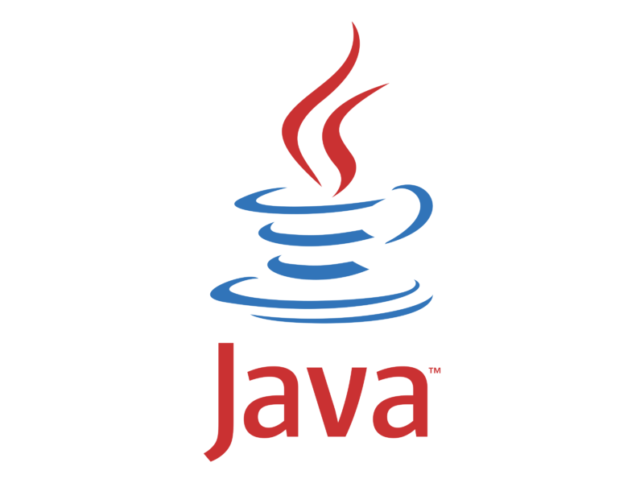



About Java
Industry standard programming language
Runs on a wide range of platforms
Great performance
Great ecosystem and community
Great virtual machine (JVM)
… but it has some pain points
Very old and keeps backward compatibility
Evolves slowly
Verbose
Some programming languages were born and tried to give better alternatives while keeping the benefits of the Java ecosystem
Notes:
Platforms: server-side, mobile, frontend
Ecosystem: tools, frameworks, libraries, open source community
Old and BW compatible: it is hard to add new features and harder to remove if it is unnecessary
Evolves slowly: new release cycle to make it faster
Groovy has performance problems, Scala can be complex and builds slowly, Clojure can be also complex and uses Lisp dialect

Slide 5

















About Kotlin
Created by JetBrains
Multi-paradigm modern programming language running on JVM
Fully interoperable with Java
Android, server-side, frontend, multiplatform, native
Great ecosystem and community
Easy to learn expressive syntax (makes you more productive):
Safer code design and fewer errors (i.e.: null safety, immutability)
Coroutines
Easy to write Domain Specific Languages
Officially supported by Google and Spring
Used for research by many universities
Used in production by many companies and organisations
Notes:
Jetbrains: good quality products, and natively supported by IntelliJ
Multi-paradigm: OOP, functional; running on JVM means it will generate Java bytecode after compilation (Multiplatform: in progress, but it let’s you write a single Kotlin code and use it on multiple platforms, so it reduces drastically the development time of these kind of projects)
Interoperability: more natural and seamless then other languages; you can use Java libraries and it allows step-by-step migration
Ecosystem and community: it has it’s own tools and frameworks, but it also can use all the Java ecosystem
Syntax: easy readability makes you more productive by allowing faster understanding of the code and spotting problems easier; flexible file structure, Lombok-like features, handy conventions
Safer code design: in Kotlin everything is a final object, and it favors immutability, what means safe code in multithreading environment
Coroutines: very lightweight threads. Usually Java applications are dying with out of memory error when using around 100K threads, but you can run millions of coroutine threads without any issues. This is a huge benefit because nowadays applications are using multithreading heavily to serve the increased amount of users.
Domain Specific Languages are higher level of abstractions used for a specific class of problems and they are using concepts from the given domain. They are real programming codes which looks more readable and understandable (they are also more reusable). This way also business people could easily understand what a fragment of code does, and they also can change it. Domain-specific languages allow non-developer domain experts to contribute to the software development process without external, costly mediation. (i.e. Markdown, CSS)
Google and Spring announced official support in 2019
Used for research because allows fast prototyping
Used by big companies in production, what means it’s not just a hype anymore
Spring is the most popular industry Java framework for server-side development
Magyar Telekom also uses Kotlin for server-side programming

Slide 6
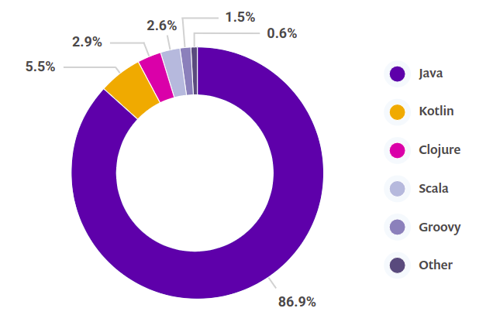
Snyk JVM Ecosystem Report 2020
Notes:
Kotlin is now the second most popular JVM language.
https://snyk.io/wp-content/uploads/jvm_2020.pdf
5.5% share but it is rapidly growing. There are a lot of jobs and java projects transforming to Kotlin
Very active community
4th fastest growing programming language after Rust, TypeScript and Python (Stackoverflow developer survey 2020)
https://insights.stackoverflow.com/survey/2020#technology-most-loved-dreaded-and-wanted-languages-loved

Slide 7

Let’s have some fun!

Slide 8
Hello, World!
fun main() { println("Hello, World!") }
public class HelloKotlinDemo { public static void main(String[] args) { System.out.println("Hello, World!"); } }
fun - keyword for function declaration (public by default)
main - main function to start application (no args required, no static)
println - prints the given string to standard output (no System.out)
no class required (with same filename)
semicolons are optional

Slide 9
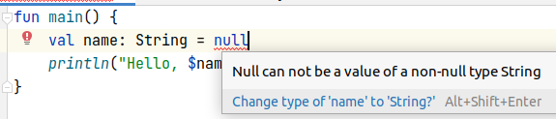
Hello, World! (variables)
fun main() { val name = "Kotlin" println("Hello, $name!") }
public class HelloKotlinDemo { public static void main(String[] args) { String name = "Java"; System.out.println("Hello, " + name + "!"); } }
val - final/immutable variable declaration (use var for mutability)
string-interpolation / templating (no concatenation; expression also allowed )
type declaration is optional (type-inference, use val name:String for explicit type)
you must be explicit if you want to use null value (val name: String? = null)
Notes:
val - you can not change it later, compiler will give you an error if you want to reassign the variable
String interpolation - the value of the object will be replaced, or the value of the expression like mathematical operations or property accessing
explicit type - you can’t assign other type to the variable, or you can assign variable later

Slide 10
Hello, World! (functions)
fun main() { println(hello("Kotlin")) } private fun hello(name: String): String { return "Hello, $name!" }
public static void main(String[] args) { System.out.println(hello("Java")); } private static String hello(String name) { return "Hello, " + name + "!"; }
everything is public by default (you must be explicit with private)
function arguments require type
functions require return type ...
… unless you can write it with a single statement (return not needed + type inference) private fun hello(name: String) = "Hello, $name!"

Slide 11
Hello, World! (functions)
hello("Kotlin", 2) //Hello, KotlinKotlin! private fun hello(name: String = "World", times: Int = 3) = "Hello, ${name.repeat(times)}!"
hello("Java", 2); private static String hello(String name, int times) { String longName = name.repeat(times); return "Hello, " + longName + "!"; }
everything is an object
complex expressions could be written within string templates by using ${}
function arguments can have default values to use in case they are not referenced hello("Kotlin") //Hello, KotlinKotlinKotlin! hello() //Hello, WorldWorldWorld!
function arguments can be referenced by name hello(name = "Kotlin", times = 2) //Hello, KotlinKotlin! hello(times = 2, name = "Kotlin") //Hello, KotlinKotlin! hello(times = 2) //Hello, WorldWorld!
no more method overloading
Notes:
Object - Kotlin will handle if something worth to convert to primitives
When a function’s arguments has default values, the argument can be omitted during function call, and the variable will get the default value
With named arguments we can change argument orders and the codebase is also more resistant to refactorings

Slide 12
Conditional expression
val number = 0 val sign = if (number < 0) -1 else if (number == 0) 0 else 1
int number = 1; int sign = 0; if (number < 0) sign = -1; else if (number == 0) sign = 0; else sign = 1;
same condition syntax as in Java (condition, statement, else branch)
if statement is an expression in Kotlin (it’s result could be assigned to a variable)
last statement of each block is an implicit return statement
Notes:
Conditional expressions help you use immutable variables when you need conditional logic (when and try is also an expression in kotlin)

Slide 13
When expression
val number: Any = 0 val sign = when (number) { 0 -> 0 -1, -2 -> -1 "-3", "-4" -> -1 is String -> 0 in 1..10 -> 1 else -> 0 }
when is similar to switch in Java, but much smarter (pattern matching)
it is also an expression (returns a value)
compare single value
compare multiple values
check value within range
compare enums or check value is within enum range
type comparison
compare any type of object (even multiple type comparison within same when statement)
else - anything not defined
Notes:
switch - multiple conditions, can be used only with string, enum, and primitives (and it’s boxed types)
when - similar to switch, but hard to make real comparison

Slide 14
Collections (lists)
val list = listOf("one", "two", "three") //[one, two, three] list + "four" //[one, two, three, four] list - "two" //[one, three] list[2] = "3" //error
List<String> list = new ArrayList<>(); list.addAll(Arrays.asList("one", "two", "three")); //[one, two, three] List<String> copy = new ArrayList<>(list); <copy>.add("four"); //[one, two, three, four] <copy>.remove("two"); //[one, three] <copy>.set(2, "3"); //[one, two, 3]
create collections by using helper methods
type aware operators to add and remove items
access items by index (array-like)
every operation on collections creates a copy of the original variable
collections are immutable by reference (use mutable* versions if needed)
Notes:
The Kotlin Standard Library provides a comprehensive set of tools for managing collections
List is an ordered collection with access to elements by indices – integer numbers that reflect their position. Elements can occur more than once in a list. An example of a list is a sentence: it's a group of words, their order is important, and they can repeat.
Collection factories since Java 9
To use immutable collections prior Java 9 you need to wrap into unmodifiable collection or to use external library.
In Kotlin mutable collections are still create copy, but allows to change data by reference
Java works on the same variable (see remove and set after)
By using immutable collections and by using copies it is possible to reduce the number of accidents and problems when working with collections

Slide 15
Collections (sets)
val set = setOf("one", "two") //[one, two] set union setOf("two", "three") //[one, two, three] set intersect setOf("two", "three") //[two] set subtract setOf("two", "three") //[one]
Set<String> set = new HashSet<>(); set.addAll(Arrays.asList("one", "two")); //[one, two] Set<String> copy = new HashSet<>(set); <copy>.addAll(Arrays.asList("two", "three")); //[one, two, three] <copy>.retainAll(Arrays.asList("two", "three")); //[two] <copy>.removeAll(Arrays.asList("two", "three")); //[one]
built in union, intersect and subtract methods for clarity
Notes:
Set is a collection of unique elements. It reflects the mathematical abstraction of set: a group of objects without repetitions. Generally, the order of set elements has no significance. For example, an alphabet is a set of letters.

Slide 16
Collections (maps)
val map = mapOf("one" to 1, "two" to 2) //{one=1, two=2} map + mapOf("two" to 22, "three" to 3) //{one=1, two=22, three=3} map - "one" //{two=2}
Map<String, Integer> map = new HashMap<>(); map.put("one", 1); map.put("two", 2); //{one=1, two=2} Map<String, Integer> otherMap = new HashMap<>(); otherMap.put("two", 22); otherMap.put("three", 3); Map<String, Integer> copy = new HashMap<>(map); <copy>.putAll(otherMap); //{one=1, two=22, three=3} <copy>.remove("one"); //{two=2}
copying and working with maps was cumbersome prior Java 9
Notes:
Map (or dictionary) is a set of key-value pairs. Keys are unique, and each of them maps to exactly one value. The values can be duplicates. Maps are useful for storing logical connections between objects, for example, an employee's ID and their position.

Slide 17
Loops
val values = arrayOf(1, 2, 3, 4, 5) for (i in values) { println(i) }
int[] values = new int[]{1, 2, 3, 4, 5}; for (int i = 0; i < values.length; i++) { System.out.println(values[i]); }
for can iterate through collections and iterables
iterations will use values, not indexes (no need to reference items by indices)
in case of maps iterations will use key-value pairs val oneTwo = mapOf("one" to 1, "two" to 2) for((k,v) in oneTwo) { println("$k -> $v") }
while and do-while also exists and works the same way

Slide 18
Ranges
for (i in 1..5) println(i) if (3 in 1..5) println("3 is between 1 and 5")
// same as before if (1 <= 3 && 3 <= 5) System.out.println("3 is between 1 and 5");
easy to create range of values
ranges can also be used in for loops
in within conditions will check if a range contains the given value
ranges can be iterated in reverse order by using downTo for (i in 5 downTo 1)
step can be used to skip some values in iteration for (i in 1..5 step 2)

Slide 19
Collection transformations
val result = (1..10) // 1 2 3 4 5 6 7 8 9 10 .filter { it % 2 == 1 } // 1 3 5 7 9 .map { it + 1 } // 2 4 6 8 10 .takeLast(3) // 6 8 10 .sum() //24
int result = IntStream.range(1, 10) .filter(n -> n % 2 == 1) .map(n -> n + 1) .skip(2) .sum();
a lot of transformation functions instantly available on collections (no stream() needed)
every transformation will create a new collection
no terminal operation required (i.e. collect(...))
most of the transformations are lambda functions { }
single input can be referred as it within lambda functions (n -> n becomes it)
many transformations are much easier with Kotlin (i.e. groupings and working with maps)
Notes:
Java stream is lazy by default. Kotlin transformations are much simpler and versatile but eager by default (there is possibility for laziness)
With Kotlin you can stop (or change) the chain of transformation anytime, because every operation creates a new collection. You don’t need to care about terminal operations. In Java streams without terminal operations you just define the chain of transformation but it will not be executed (you must subscribe with a terminal operation)

Slide 20
Classes
final, public class with single property (immutable)
constructor with default property value
constructor to pass property value
property getter
print by creating new object and getting property
final public class Person { final private String name; public Person() { this.name = "John Doe"; } public Person(String name) { if (name == null) { this.name = "John Doe"; } else { this.name = name; } } public String getName() { return this.name; } } System.out.println("Hi, " + new Person().getName() +"!"); //Hi, John Doe!
Notes:
Classes are used to hold data and state.
This is how you would write a simple immutable class what is equivalent with Kotlin class on the next slide.
It gets worse with mutable classes (setters) and with equals/hashCode/toString methods

Slide 21
Classes
class Person(val name: String = "John Doe") println("Hi, ${Person().name}!") //Hi, John Doe!
this is the same class in Kotlin
new keyword not needed when creating object
access property directly
constructors and getters are generated at bytecode (setters when class is mutable; no more Lombok)
it is also possible to have custom constructor or initializer
in Java usually we do not handle null or default values (in Kotlin it is easy)
named arguments could be used (no builders needed)
Notes:
This line of code:
Defines a public, final class
Defines public final property, with getter (and with setter if it’s mutable by using var)
Defines default value for the property
Defines constructor to pass value to property

Slide 22


Slide 23

Demo
Notes:
flexible file, class and package structure helps you to get your ideas down as fast as you can
easy to create data models with default values and see them all in one place
object creation is more flexible and readable with named arguments (you see what are the arguments, you can change orders, no builders needed)
easy to create immutable objects what are thread safe
variable and function names can be more readable with backticks (but it is not advised except of tests)
simple to create lists and maps (it is cumbersome prior Java 9, and nearly 60% of IT still using Java 8)
easier to read and write strings
most of the time people transform data, and Kotlin helps you a lot in this (very easy to read, straightforward and expressive)
it is possible to transform data by using loops and conditions, but many times you need to break immutability for this, what will cause strange problems later
you have to be explicit when and how to handle nullable values (so you have less chance to have NullPointerExceptions by accident, and most of the errors are related to NPEs)
modern Java can be almost that expressive as Kotlin, but it does not LTS version and IT is stuck on Java 8
Kotlin is safer (more typesafe, more compile time errors)
Kotlin can help you much more then Java in other areas what we did not covered yet (more advanced topics like writing DSLs or multithreading)

Slide 24


Resources
Demo: https://github.com/domahidizoltan/presentation-hello-kotlin
Kotlin language guide: https://kotlinlang.org/docs/reference/
Kotlin Playground: https://play.kotlinlang.org/
Dmitry Jemerov and Svetlana Isakova: Kotlin in Action

